Slide 1
Solving problems by searching
Chapter 3

Slide 2
Outline
Problem-solving agents
Problem types
Problem formulation
Example problems
Basic search algorithms

Slide 3

Problem-solving agents

Slide 4
Example: Romania
On holiday in Romania; currently in Arad.
Formulate goal:
  be in Bucharest
Formulate problem:
  states: various cities
  actions: drive between cities
Find solution:
  sequence of cities, e.g., Arad, Sibiu, Fagaras, Bucharest

Slide 5

Example: Romania

Slide 6
Problem types
Deterministic, fully observable → single-state problem
  Agent knows exactly which state it will be in; solution is a sequence
Non-observable → sensorless problem
Agent may have no idea where it is; solution is a sequence
Nondeterministic and/or partially observable → contingency problem
  percepts provide new information about current state
  often interleave search, execution
Unknown state space → exploration problem

Slide 7

Example: vacuum world
Single-state, start in #5. Solution?

Slide 8
Example: vacuum world
Single-state, start in #5.
Solution? [Right, Suck]
Sensorless, start in
{1,2,3,4,5,6,7,8} e.g.,
Right goes to {2,4,6,8}
Solution?

Slide 9
Example: vacuum world
Sensorless, start in
{1,2,3,4,5,6,7,8} e.g.,
Right goes to {2,4,6,8}
Solution?
[Right,Suck,Left,Suck]
Contingency
  Nondeterministic: Suck may
  dirty a clean carpet
  Partially observable: location, dirt at current location.
  Percept: [L, Clean], i.e., start in #5 or #7
  Solution?

Slide 10
Example: vacuum world
Sensorless, start in
{1,2,3,4,5,6,7,8} e.g.,
Right goes to {2,4,6,8}
Solution?
[Right,Suck,Left,Suck]
Contingency
  Nondeterministic: Suck may
  dirty a clean carpet
  Partially observable: location, dirt at current location.
  Percept: [L, Clean], i.e., start in #5 or #7
  Solution? [Right, if dirt then Suck]

Slide 11
Single-state problem formulation
A problem is defined by four items:
initial state e.g., "at Arad"
actions or successor function S(x) = set of action–state pairs
  e.g., S(Arad) = {<Arad → Zerind, Zerind>, … }
goal test, can be
  explicit, e.g., x = "at Bucharest"
  implicit, e.g., Checkmate(x)
path cost (additive)
  e.g., sum of distances, number of actions executed, etc.
  c(x,a,y) is the step cost, assumed to be ≥ 0
A solution is a sequence of actions leading from the initial state to a goal state

Slide 12

Vacuum world state space graph
states?
actions?
goal test?
path cost?

Slide 13
Vacuum world state space graph
states? integer dirt and robot location
actions? Left, Right, Suck
goal test? no dirt at all locations
path cost? 1 per action

Slide 14

Example: The 8-puzzle
states?
actions?
goal test?
path cost?

Slide 15
Example: The 8-puzzle
states? locations of tiles
actions? move blank left, right, up, down
goal test? = goal state (given)
path cost? 1 per move

Slide 16

Example: robotic assembly
states?: real-valued coordinates of robot joint angles parts of the object to be assembled
actions?: continuous motions of robot joints
goal test?: complete assembly
path cost?: time to execute

Slide 17
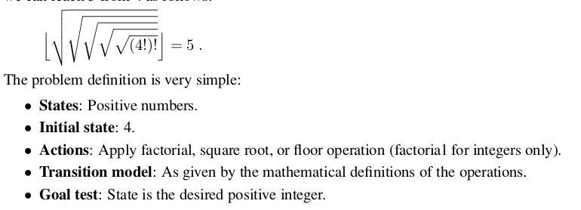
floor(sqrt(sqrt(sqrt(sqrt(sqrt(factorial(factorial(4))))))))

Slide 18
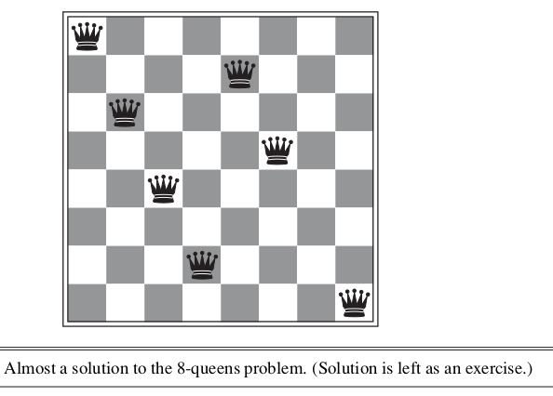

Slide 19
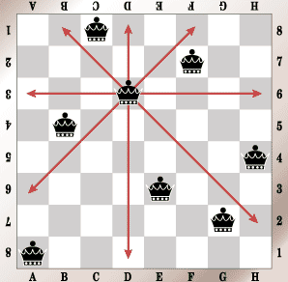

Slide 20
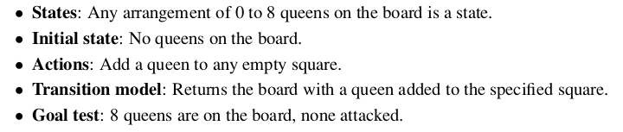

Slide 21

Tree search algorithms
Basic idea:
  offline, simulated exploration of state space by generating successors of already-explored states (a.k.a.~expanding states)

Slide 22

Tree search example

Slide 23

Tree search example

Slide 24

Tree search example

Slide 25

Implementation: general tree search

Slide 26

Implementation: states vs. nodes
A state is a (representation of) a physical configuration
A node is a data structure constituting part of a search tree includes state, parent node, action, path cost g(x), depth
The Expand function creates new nodes, filling in the various fields and using the SuccessorFn of the problem to create the corresponding states.

Slide 27
Search strategies
A search strategy is defined by picking the order of node expansion
Strategies are evaluated along the following dimensions:
  completeness: does it always find a solution if one exists?
  time complexity: number of nodes generated
  space complexity: maximum number of nodes in memory
  optimality: does it always find a least-cost solution?
Time and space complexity are measured in terms of
  b: maximum branching factor of the search tree
  d: depth of the least-cost solution
  m: maximum depth of the state space (may be ∞)

Slide 28
Uninformed search strategies
Uninformed search strategies use only the information available in the problem definition
Breadth-first search
Uniform-cost search
Depth-first search
Depth-limited search
Iterative deepening search

Slide 29

Breadth-first search
Expand shallowest unexpanded node
Implementation:
  fringe is a FIFO queue, i.e., new successors go at end

Slide 30

Breadth-first search
Expand shallowest unexpanded node
Implementation:
  fringe is a FIFO queue, i.e., new successors go at end

Slide 31

Breadth-first search
Expand shallowest unexpanded node
Implementation:
  fringe is a FIFO queue, i.e., new successors go at end

Slide 32

Breadth-first search
Expand shallowest unexpanded node
Implementation:
  fringe is a FIFO queue, i.e., new successors go at end

Slide 33
Properties of breadth-first search
Complete? Yes (if b is finite)
Time? 1+b+b²+b³+… +b^{d} + b(b^{d}-1) = O(b^{d+1})
Space? O(b^{d+1}) (keeps every node in memory)
Optimal? Yes (if cost = 1 per step)
Space is the bigger problem (more than time)

Slide 34
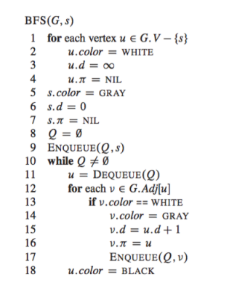
BFS for graph
Source: Introduction To Alg.
By T. Cormen

Slide 35
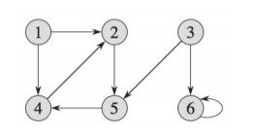
Directed Graph

Slide 36
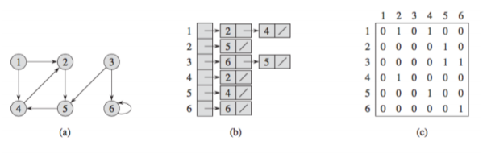
Matrix representation
Linked list

Slide 37
